Slide 1

Stage 3 Pizza Hut Course Designer: Jordan Rogers
Pizza Hut is a 25 round, 125 point Comstock Long course. There are 10 IPSC targets and 5 steel targets. The best two hits per target will score. Steel must fall to score. The start signal is audible.
The start position is standing completely outside the shooting area with toes touching marks, facing DIRECTLY down range. Handgun: loaded and holstered. PCC: loaded, stock on belt, muzzle pointing down range.
On the audible start signal, engage all targets from within the shooting area. Popper 1 activates the swinger, which is a disappearing target.

Slide 2
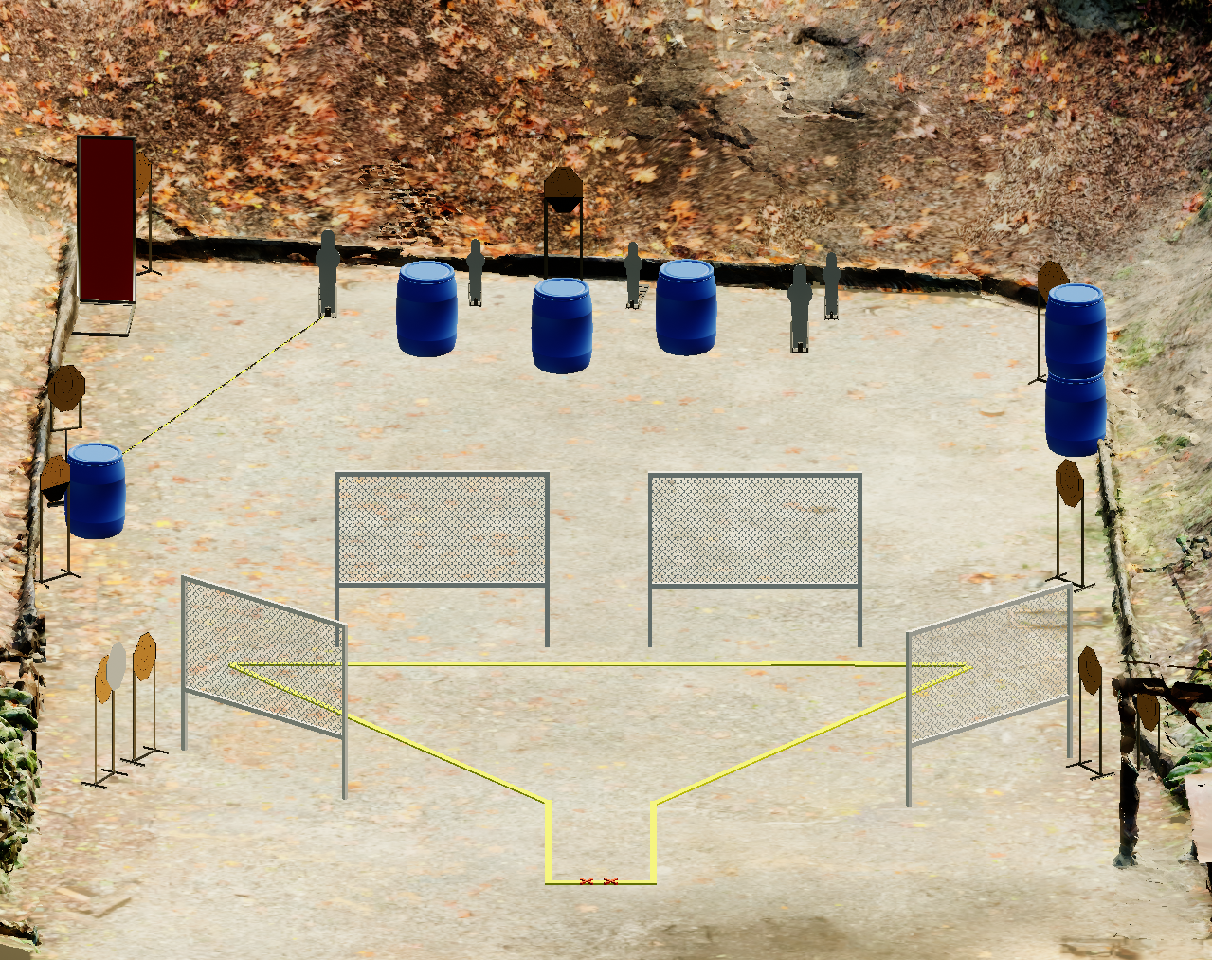
 | Stage 3 Pizza Hut Course Designer: Jordan Rogers

